Slide 1
IMAGE PROCESSING PROJECT WORK “Using c-LANGUAGE”
SUBMITTED TO: SUBMITTED BY:
DR. CHANDRA PRAKASH 1)AYUSH YADAV(191220016)
2)RAYAN MAHFOOS(191220054)
BRANCH: ECE
GROUP NO.: 25

Slide 2
IMAGE FORMAT: BITMAP IMAGE(.BMP)
A bitmap image is a raster image (containing pixel data as opposed to vector images) format. Each pixel of a bitmap image is defined by a single bit or a group of bits. Hence, it is called the bitmap or a map of bits and pixels.
Bitmap AKA Device Independent Bitmap(DIB) was designed by Windows Corporation to easily exchange images between different devices without worrying about the device’s logic to display raster images on the screen. These files have .bmp or .dib extensions.

Slide 3
BMP allows encoding images in different color depths. The color depth is a measure of an individual image pixel to accurately represent a color. Color depth is calculated in bits-per-pixel or bpp.
For example, 1-bit color depth or 1bpp means a pixel can have a 1-bit color or 2 values. Monochromatic images have 1-bit color depth because a pixel can be true black or true white. BMP format supports 1-bit, 2-bit, 4-bit, 16-bit, 24-bit, and 32-bit color depths. BMP allows an alpha-channel to add transparency in the image using 32-bit color depth.
Since Bitmap images are great at storing raw-uncompressed data, they are great for archival purpose and image processing

Slide 4


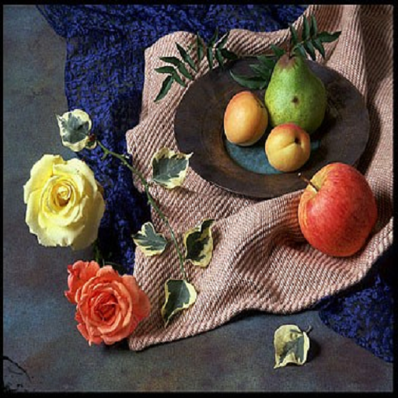
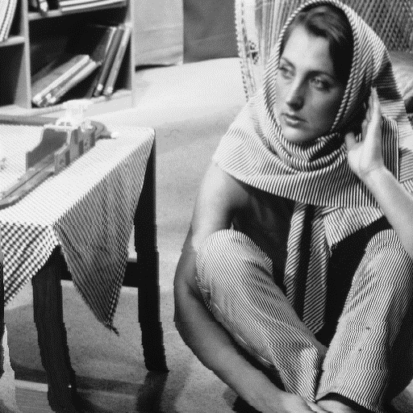
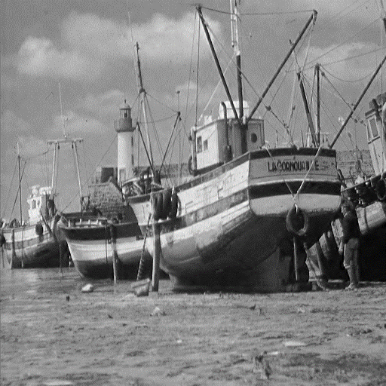
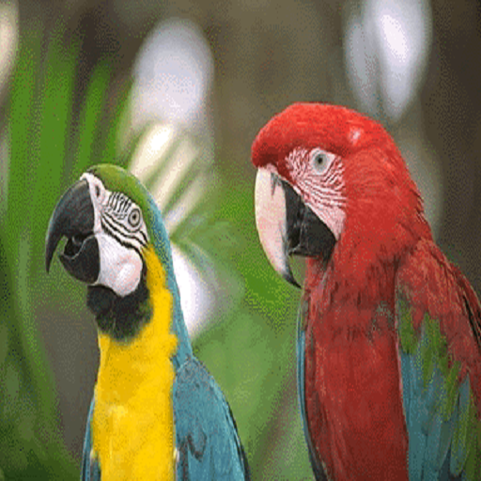
Images used to perform the functions
1)”lenargb.bmp” 2)”lenagray.bmp” 3)”fruit.bmp”
4)”Barbara.bmp” 5)”ships.bmp” 6)”parrots.bmp”

Slide 5
Functions performed
1) Grayscale to binary conversion
2) Colour to grayscale conversion
3) Getting image details
4) Negative of grayscale image
5) Cropping the image
6) To flip in Horizontal and Vertical direction
7) To calculate average grey level of image
8) To convert grayscale image to binary(0,1) in Text file
9) Morphing 2 images

Slide 6
10) Getting the pixel information
11) Setting the pixel value
12) Application of settingpixel() function (chess design)
13) Translating the image by a factor of “t”.
14) Rotation of image by angle 
15) FILTERS:
a)brightening filter.
b)blur filter.
c)sepia filter.
d)smooth(mean) filter.

Slide 7
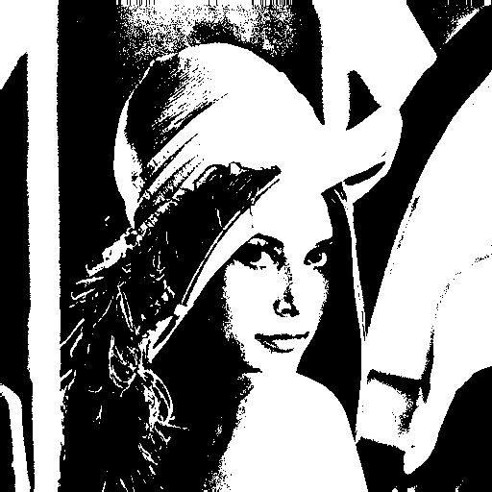
1) Grayscale to binary conversion
This function convert the grayscale image into the binary format i.e. Black& White format
Logic:
If the pixel value at a particular location is more then threshold(128) value the function will assign it WHITE(255) value else BLACK(0) value.
for(int k=0;k< height ; k++) //store 0(black) and 255(white) values to space
{ for(int j=0;j< width ;j++)
{ space[k][j]=(space[k][j] > THRESHOLD) ? WHITE : BLACK;
}
} ----->
{ code is taken from the program}
INPUT OUTPUT

Slide 8
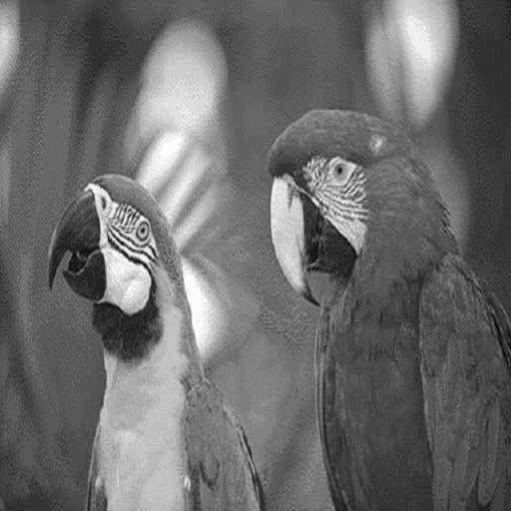
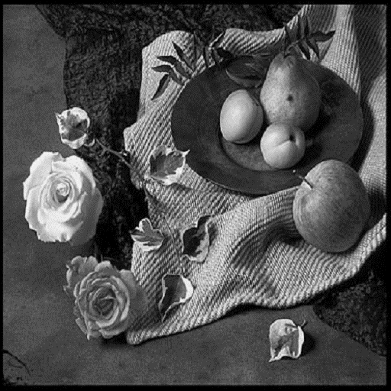
2) Colour to grayscale conversion
“color2gray()” function converts the colour(RGB) bitmap image to a grayscale bitmap image
Logic:
using the conversion formula we multiply the particular pixel that is constructed with the red , blue and green colour with the respective value.
for(int i=0;i< size ;i++) //RGB to grey
{ x=0; INPUT OUTPUT
space[i][2]=getc(t); //blue
space[i][1]=getc(t); //green
space[i][0]=getc(t); //red
x=(space[i][0]*0.29) + (space[i][1]*0.59)+ (space[i][2]*0.11); //conversion formula putc(x,f); -------->
putc(x,f);
putc(x,f);
}
{code is taken from the program}
---------->

Slide 9
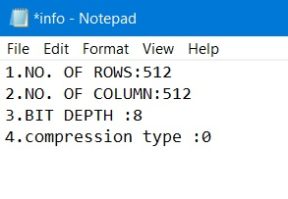
3) Getting image details
The function “getinfo()”,simply returns the no. of rows , no of column , Bit depth etc of the image in form of a text file.
LOGIC:
We have to read the header of the image which contains the details about the height, width etc and then store the useful information in a “info.txt” file
EXAMPLE: OUTPUT:

Slide 10
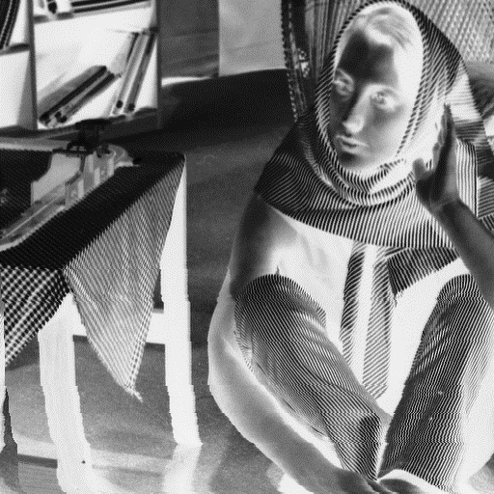
4) Negative of grayscale image
The function “negative()” converts the grayscale image into the negative where the lighter areas of the image appears darker and darker area of the image appear to be lighter.
LOGIC:
we simply subtract the pixel value from 255 to get the opposite color.
for(int i = 0; i < height; i++)
{
for(int j = 0; j < width; j++) INPUT: OUTPUT:
{
oData[i*width + j] = 255 - iData[i*width + j];
}
}
------->

Slide 11
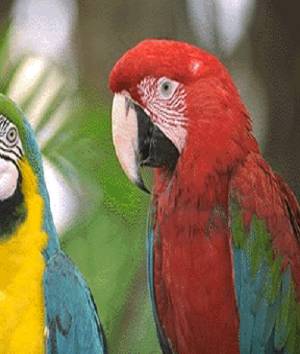

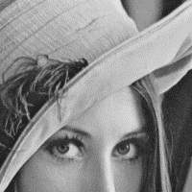
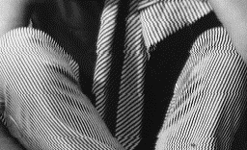
5) Cropping the image
The function “crop(int ULr,int ULc,intLRr,intLRc)” resizes the image to get required size it accepts the four argument the coordinates of Upper Left row & column and Lower Right row &column from here the height and width of final image is obtained.
LOGIC:
we modify the header to the bmp image to the required height & width and then operate the two loop up to the size of final image which will print the image to a new file
*(int*)&header[18]=resizewidth; //newwidth
*(int*)&header[22]=resizeheight; //newheight
SAMPLES:
200X200 336X44 256X156 453X384

Slide 12
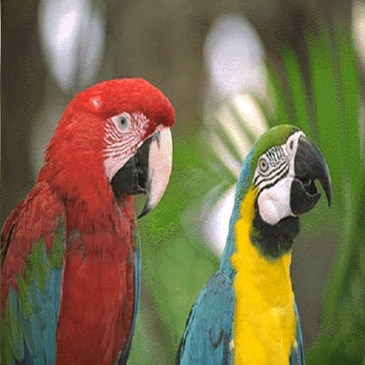
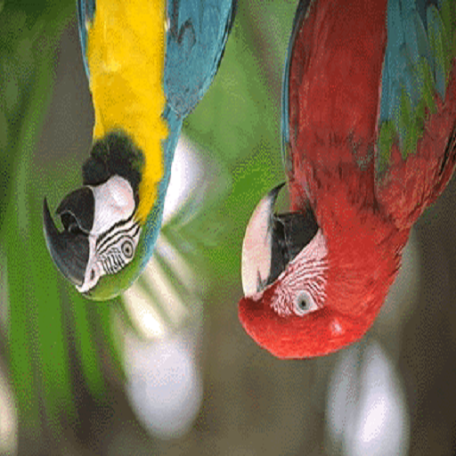
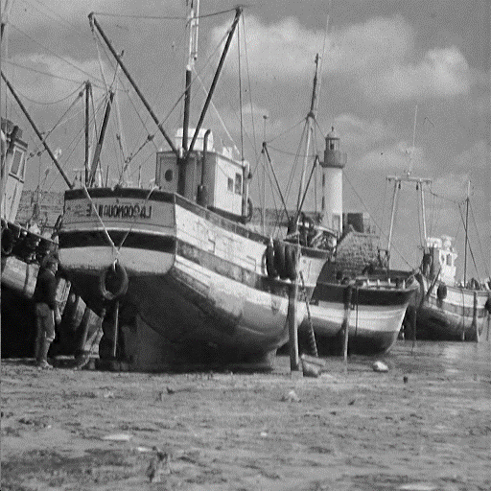
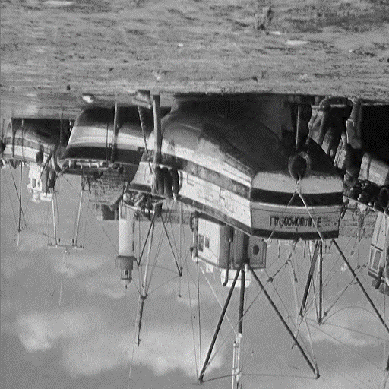
6) To flip in Horizontal and Vertical direction
The function flips the image along vertically (y –axis) & along horizontally (x-axis)
LOGIC:
To flip along Y-axis we exchange the pixel contents of 1st column with the last column.
To flip along X-axis we exchange the pixel content of 1st row with the last row.
SAMPLE:
INPUT-1 VERTICALLY HORIZONTALLY INPUT-2 VERTICALLY HORIZONTALLY
→ →

Slide 13
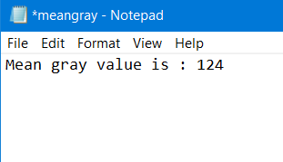
7) To calculate average grey level of image
The function “meangray()” tells about the average gray level value of the image
LOGIC:
It adds the pixel value of every pixel in a separate variable and then divides it with the size of the image to get the output and stores it in the FILE “meangray.txt”.
for(int k=0;k<height;k++)
{ for(int j=0;j<width;j++)
count=count+(int)space[k][j];
}
count=count/size; INPUT: OUTPUT:
EXAMPLE:

Slide 14

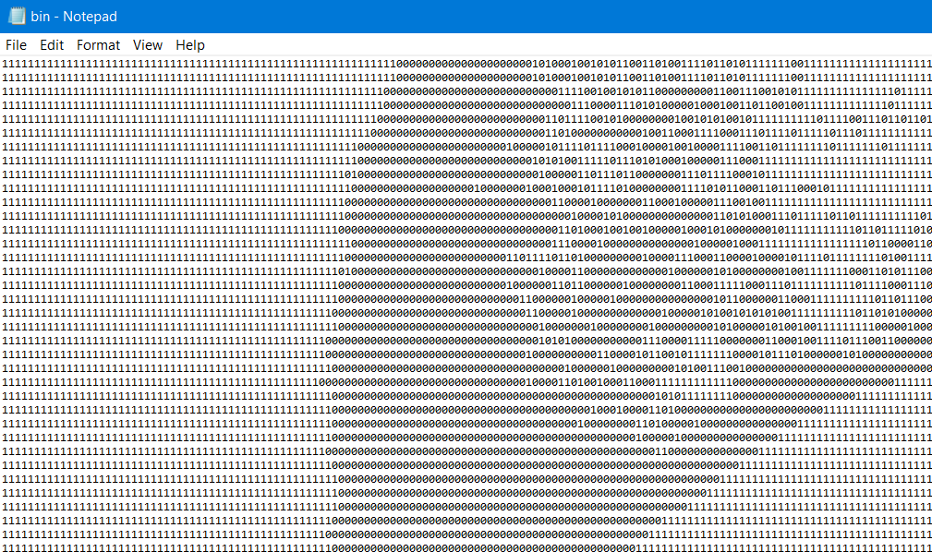
8) To convert grayscale image to binary(0,1) in Text file
This function convert the grayscale image into the binary format(0,1) to a text FILE.
Logic:
If the pixel value at a particular location is more then threshold(128) value the function will assign it “1”value else “0” value.
sample:
INPUT: OUTPUT:

Slide 15
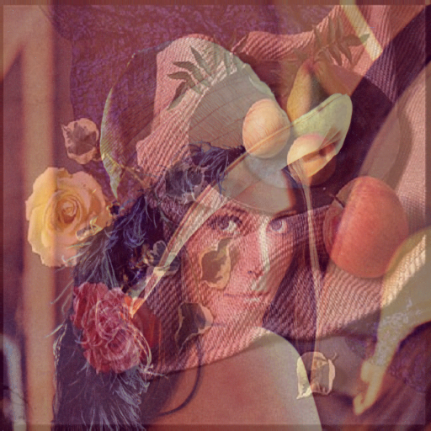
9) Morphing 2 images
The function “morph()” takes two image i.e. combine them into a single image by particular ratio
LOGIC:
The function adds the pixel of the both image to produce the output . Where value of “tt” is in the range(0,0.1….1)
for(int k=0;k<height;k++)
{ for(int j=0;j<width;j++)
r.space[k][j]=(1-tt)*r.space[k][j]+tt*r.spacex[k][j];
}
fwrite(r.space,sizeof(unsigned char),size,f); INPUT OUTPUT
+ =

Slide 16
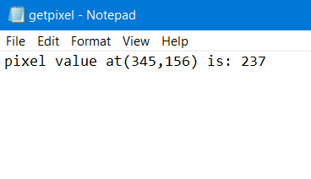
10) Getting the pixel information
This function returns the pixel value at a particular row & column coordinates this function works both on the grayscale and RGB image as well.
LOGIC:
The function first read the image and then print the pixel value of the row & column coordinates entered by the user in the text file “getpixel.txt”.
fprintf(f,"pixel value at(%d,%d) is: %d",r,c,space[r][c]);
INPUT: OUTPUT:

Slide 17
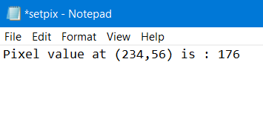
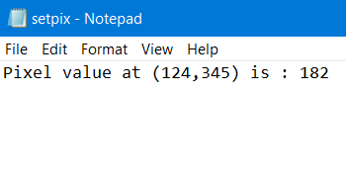
11)Setting the pixel value
This function will set the custom pixel value at the particular location ,entered by the user, this operation is both functional for grayscale and RGB type bmp image
LOGIC:
The function first read the image data then modify the particular pixel and then store it into the “setpix.txt” FILE.
if(bitDepth <= 8)
{ fread(colorTable, sizeof(unsigned char), 1024, t);
fread(space,sizeof(unsigned char),size,t); //read image data
space[r][c]=value;
fprintf(f,"Pixel value at (%d,%d) is : %d",r,c,space[r][c]);
}
INPUT-1 OUTPUT: INPUT-2 OUTPUT:
EXAMPLE:

Slide 18
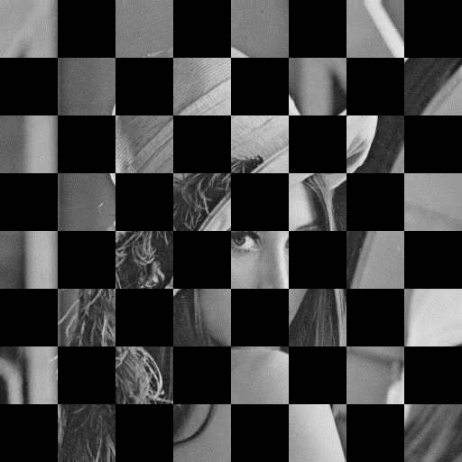
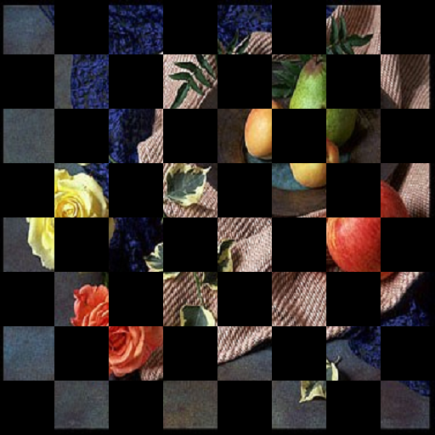
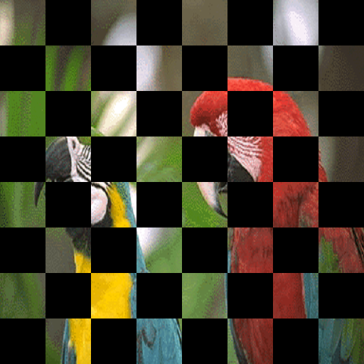
12)Application of settingpixel() function (chess design)
In this function it uses the feature of “setpixel()” and modify the image into a chess board design.
LOGIC:
//this logic is for grayscale image , for RGB consider the code
while(z!=4)
{ while(i!=4)
{ for(int k=i*128;k<(i*128+64);k++)
{ for(j=z*128;j<(z*128+64);j++)
{
space[k][j]=space[j+64][k+64]=0;
}
}
++i;
}i=0;
++z;
}

Slide 19
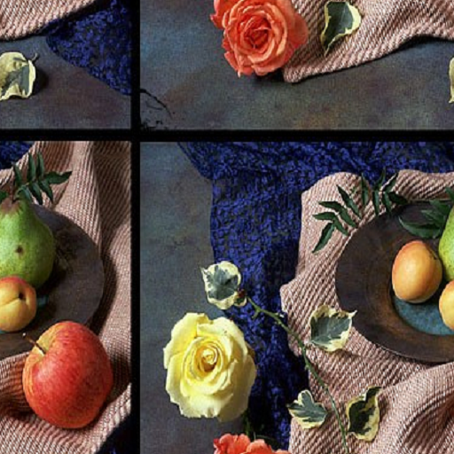
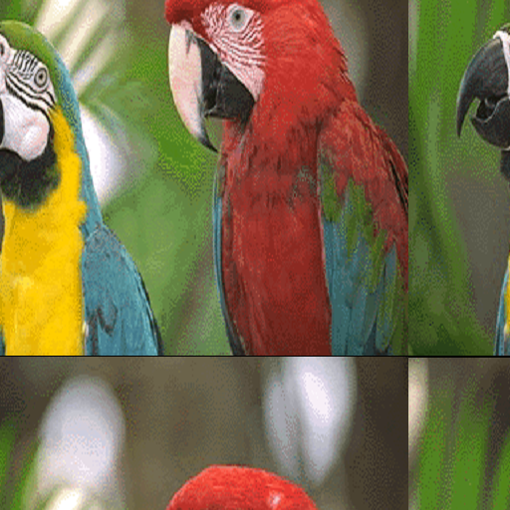
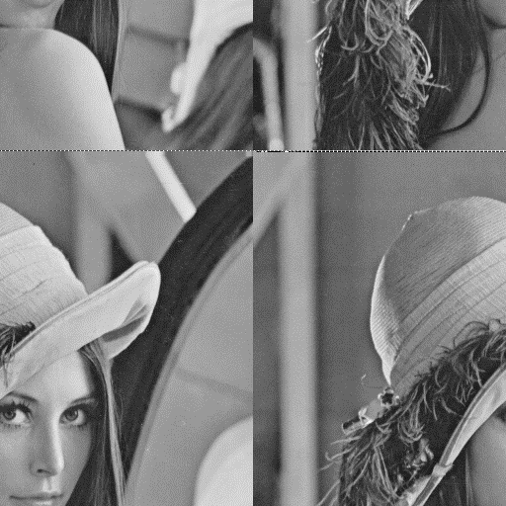
13)Translating the image by a factor of “t”.
The function “translate(int r , int c)” translate the image in horizontal and vertical direction as per the requirement specified by the user , Where “r” & “c” in the range(1,2…10).
LOGIC:
Using the two for loop we translate the image , we store the new coordinate (x,y) of the original image into a new location that will be used to print it in the FILE “translate.txt”
for(int k=0;k<height;k++)
{ for(int j=0;j<width;j++)
{ x=k+tt; OUTPUT-1 OUTPUT-2 OUTPUT-3
y=j+ttt;
if(x>height)
x=x-height;
r.space[k][j]=space[x][y];
}
}

Slide 20
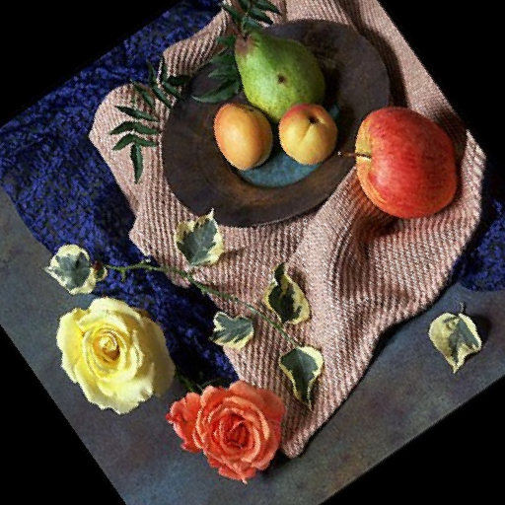
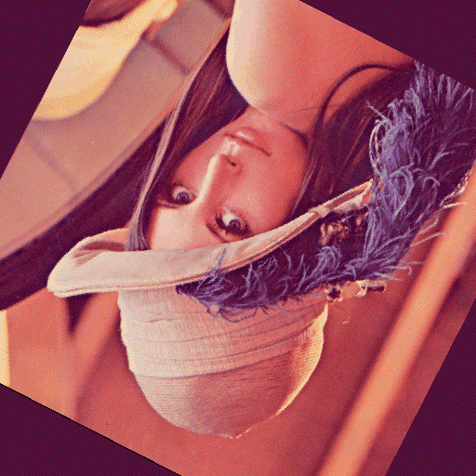
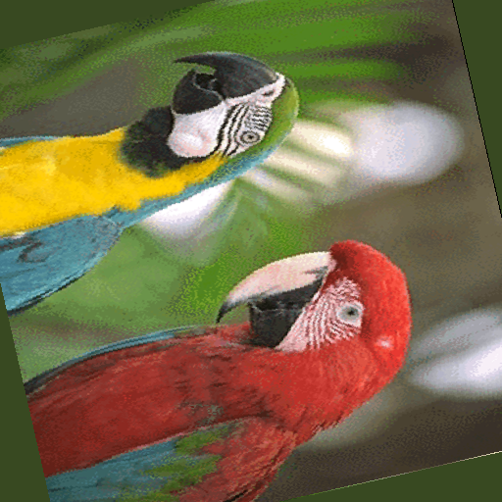
14)Rotation of image by angle 
This function performs the rotation on the image by any angle , entered by the user.
LOGIC:
The image is rotated along the centre and the new coordinate is obtained using the below formula ,where “centre” is equal to the height/2 ,
//for full explanation refer README FILE.
x=(k-centre)*cos(a)-(j-centre)*sin(a)+centre;
y=(k-centre)*sin(a)+(j-centre)*cos(a)+centre; OUTPUT-1 OUTPUT-2 OUTPUT-3
=35 degree =153 degree =284 degree

Slide 21
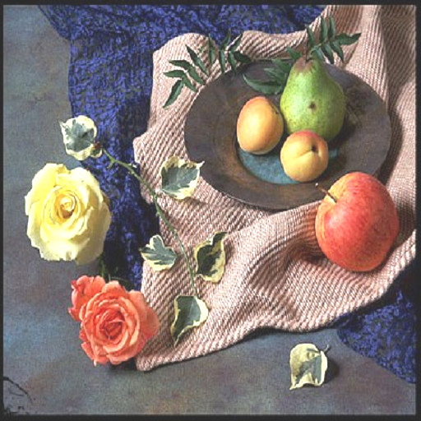
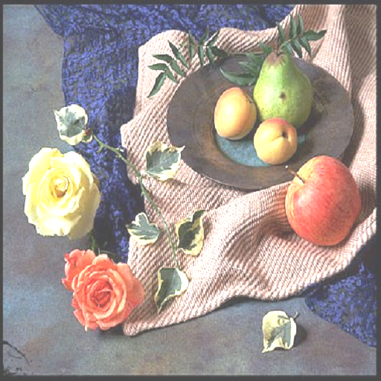
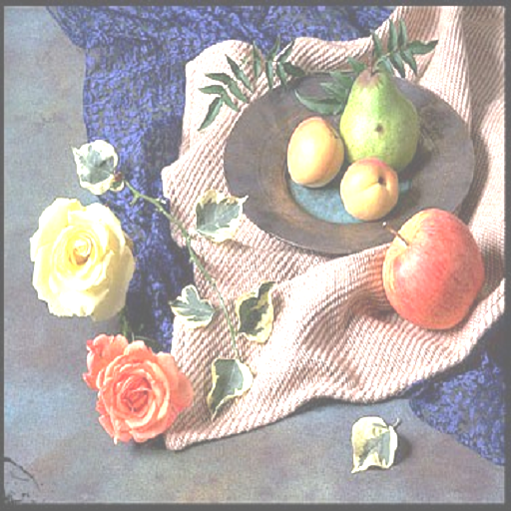
FILTERS: a) the brightening filter
Using this function the brightness of the image is increases , according to the value entered by the user .
LOGIC:
At every pixel there is addition of some extra value i.e. “BRIGHTNESS”
temp0 = buffer[i][0] + BRIGHTNESS;
temp1 = buffer[i][1] + BRIGHTNESS;
temp2 = buffer[i][2] + BRIGHTNESS;
ORIGINAL IMAGE: BRIGHTNESS LEVEL 43 BRIGHTNESS LEVEL 74 BRIGHTNESS LEVEL 100

Slide 22
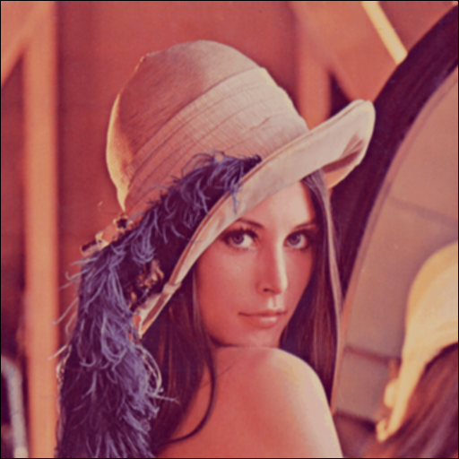
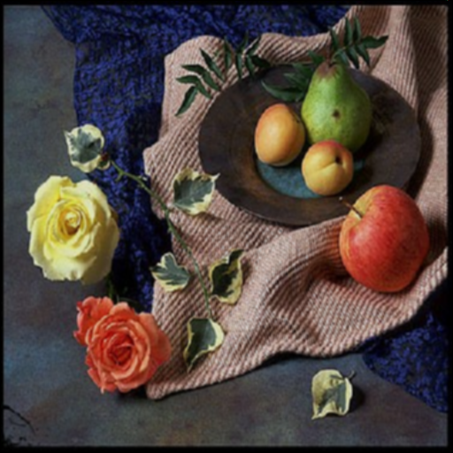
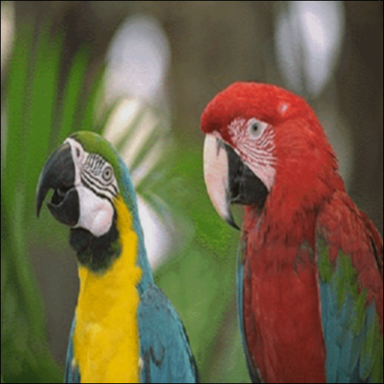
b)The Blur filter
Using this filter we can make the image to appear blur/hazy by a fixed value.
LOGIC:
We create a 3X3 matrix where we store the blurring factor and then multiply it with the array where our image is stored , to get the desired result.
Sample images:
//these images don’t look like blurred(due to small size) but the actual images we get after running the code are blurred.

Slide 23
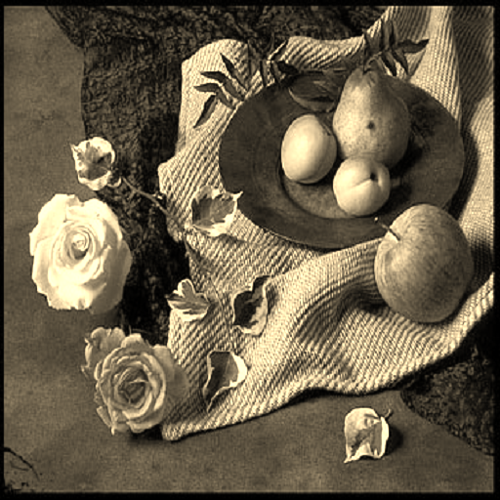

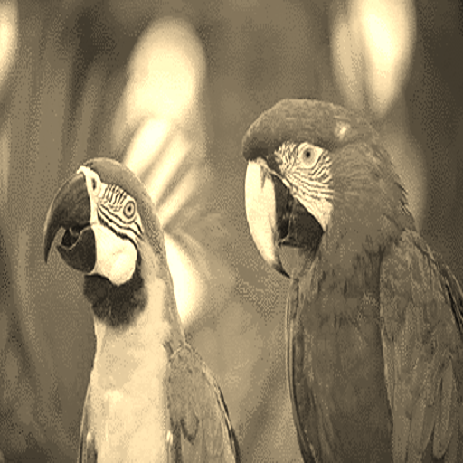
C) THE SEPIA FILTER
Using “sepia()” function we get the Brownish colour effect on our image.
LOGIC:
We implement this function by using the below formula ,that’s basically multiply every pixel with a particular value to get the effect
r = (buffer[i][0]*0.393) + (buffer[i][1]*0.769)+ (buffer[i][2]*0.189);
EXAMPLE:
INPUT-1 OUTPUT INPUT-2 OUTPUT

Slide 24
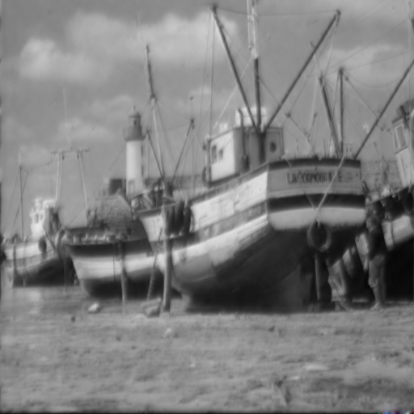

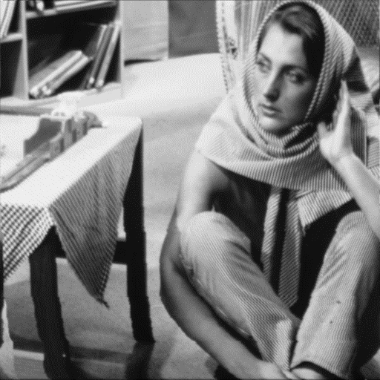

D) smooth(mean) filter
Using this filter we create the smooth image that particularly reduces the noise in the original image
LOGIC:
We replaces the pixel value with the mean of the surrounding pixels , by using the below formula.
space[k][j]=(space[k][j]+space[k+1][j]+space[k+1][j+1]+space[k][j+1]+space[k-1][j+1]+space[k-1][j]+space[k-1][j-1]+space[k-1][j]+space[k+1][j-1])/9;
EXAMPLE:

Slide 25
REFRENCES
http://homepages.inf.ed.ac.uk/rbf/HIPR2/
https://www.tutorialspoint.com/dip/concept_of_bits_per_pixel.htm
https://github.com/abhijitnathwani/image-processing
https://github.com/jkaramichos/bmp_image
https://itnext.io/bits-to-bitmaps-a-simple-walkthrough-of-bmp-image-format-765dc6857393

Slide 26
THANK YOU

